Slide 1
Analysis and Prediction of Credit Loan Defaults
Presented by-
Mr. Balaji Shewale PRN: 210940125011
Mr. Harsh Mohan PRN: 210940125019
Mr. Balkrishna Nandavadekar PRN: 210940125027
Mr. Omkar Lokhande PRN: 210940125030
Mr. Vedant Deshpande PRN: 210940125053

Slide 2
Introduction
Credit card has been one of the most booming financial services by banks over the past years.
With the growing number of credit card users, banks have been facing an escalating credit card default rate.
Some people for one reason or another, do not keep up on their payments and eventually go into credit card default.
Credit card default is the term used to describe what happens when a credit card user makes purchases by charging them to their credit card and then they do not pay their bill.
This study aims at using data of the customer to predict whether the customer will default by various statistical techniques and building different models for the same.

Slide 3
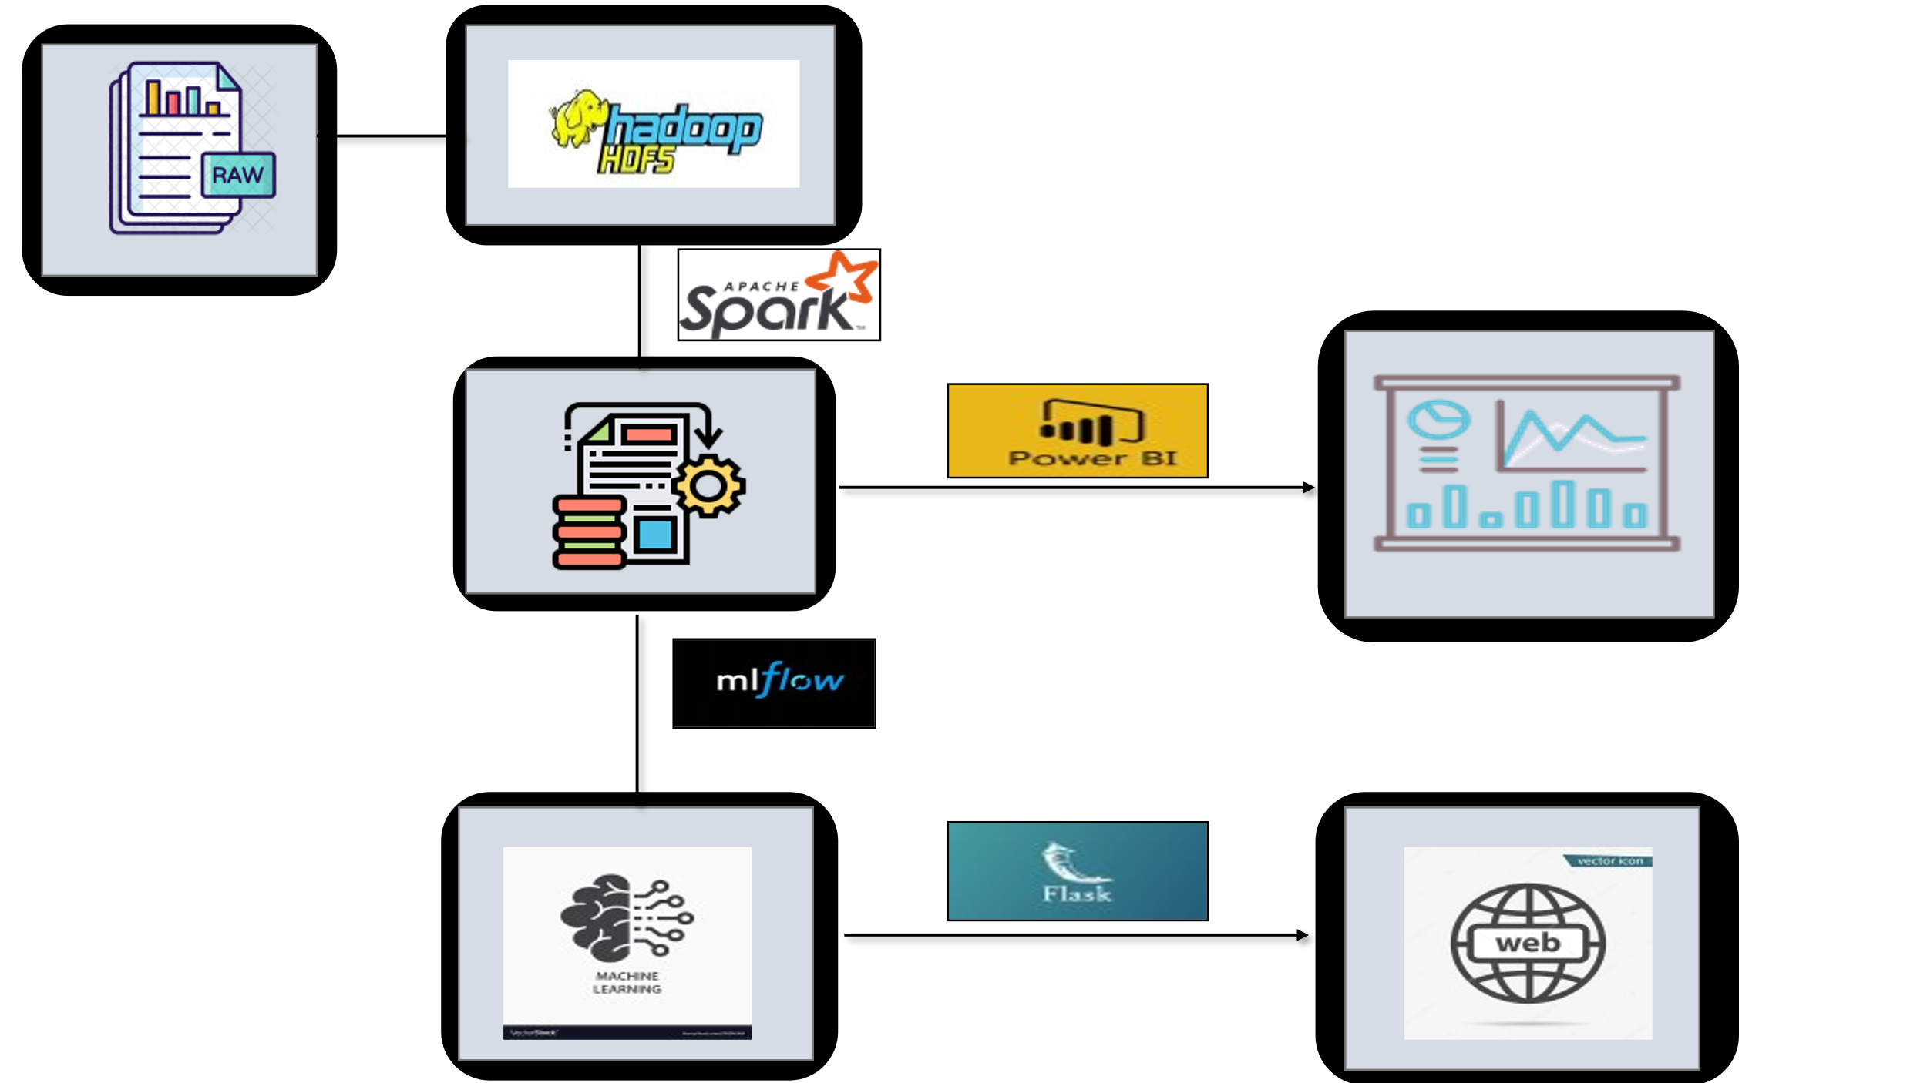
Flowchart

Slide 4
Dataset Description
We have imported the Credit card default dataset from KAGGLE
It contains the following 19 fields
customer_id 7. no_of_children 13. yearly_debt_payments
Name 8. net_yearly_income 14. credit_limit
Age 9. no_of_days_employed 15. credit_limit_used(%)
Gender 10. occupation_type 16. credit_score
owns_car 11. migrant_worker 17. prev_defaults
owns_house 12. yearly_debt_payments 18. credit_card_default
7. default_in_last_6months 19. total_family_members

Slide 5
Data Pre-processing
Column Drop
The count of NAN and Null values
Imputing numerical data with median and categorical data with mode
Box-plot to detect the outliners
Replacing outliner with mean
Feature Selection using Correlation

Slide 6
Data Visualization

Slide 7
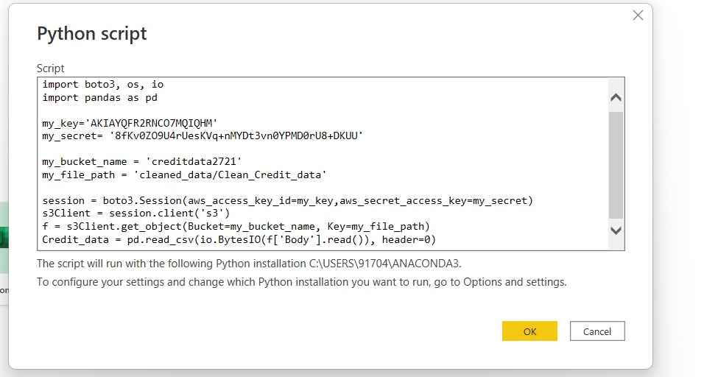
Integrating Power Bi and AWS S3 Bucket

Slide 8
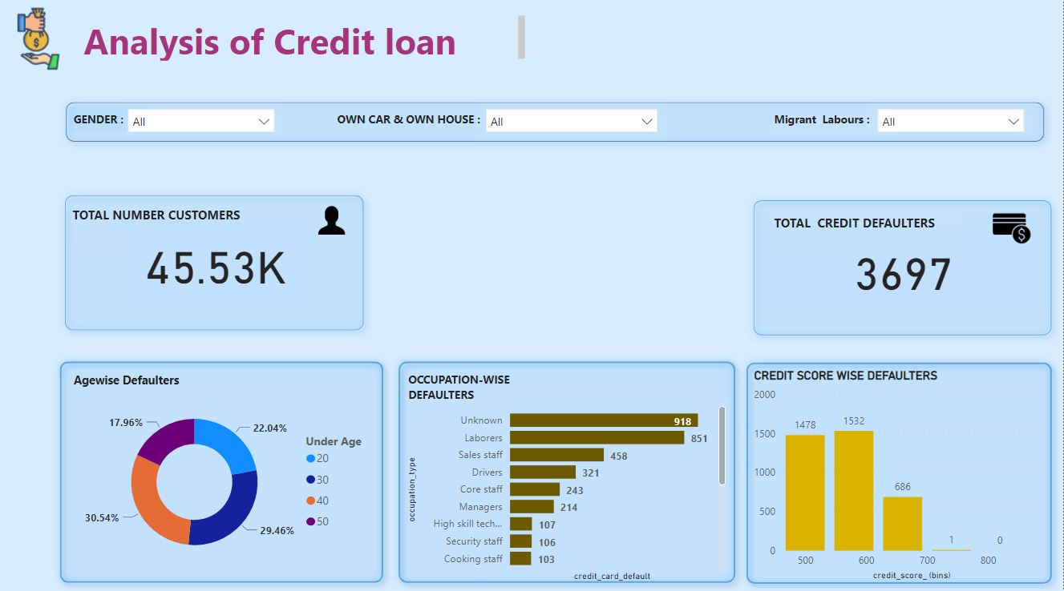
Creating Dashboard

Slide 9
Model Building

Slide 10
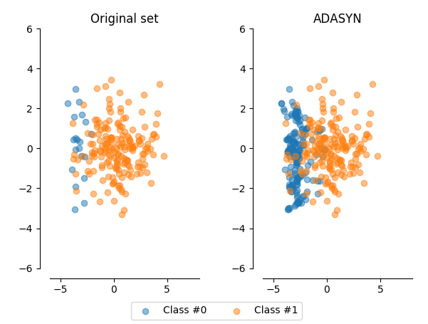
Data pre-processing
Hot Encoding
Scaling
Synthetic Oversampling

Slide 11
Models Used
Ann
Random Forest
Gradient boost
Stacking
Voting

Slide 12
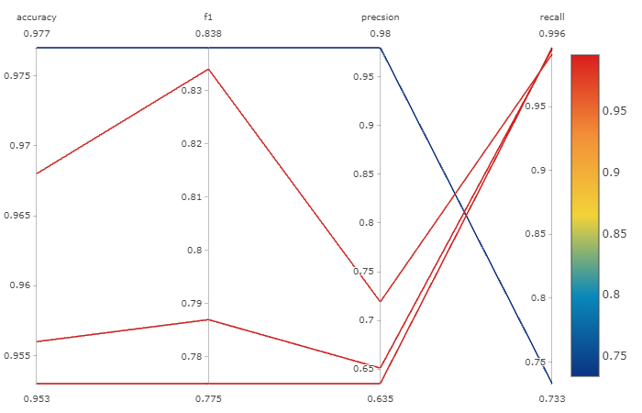
mlflow visualisation

Slide 13
TIME TO DEPLOY OUR WORKING MODEL

Slide 14


LIBRARY USED
FLASK-
Flask is a micro web framework, lightweight written in Python. It is classified as a microframework
PICKLE-
The pickle module implements binary protocols for serializing and de-serialization a Python object structure
---- Code snippets---
import pickle
pickle.dump(pipe,open('pipe.pkl','wb'))

Slide 15
Some basic information --
Some API of Scikit-learn helpful for fast deployment
1)Column Transformer()--This estimator allows different columns or column subsets of the input to be transformed separately and the features generated by each transformer will be concatenated to form a single feature space
2)Pipeline()--Sequentially apply a list of transforms and a final estimator. The purpose of the pipeline is to assemble several steps that can be cross-validated together i.e model , tranfomers1 ,transformer2..

Slide 16
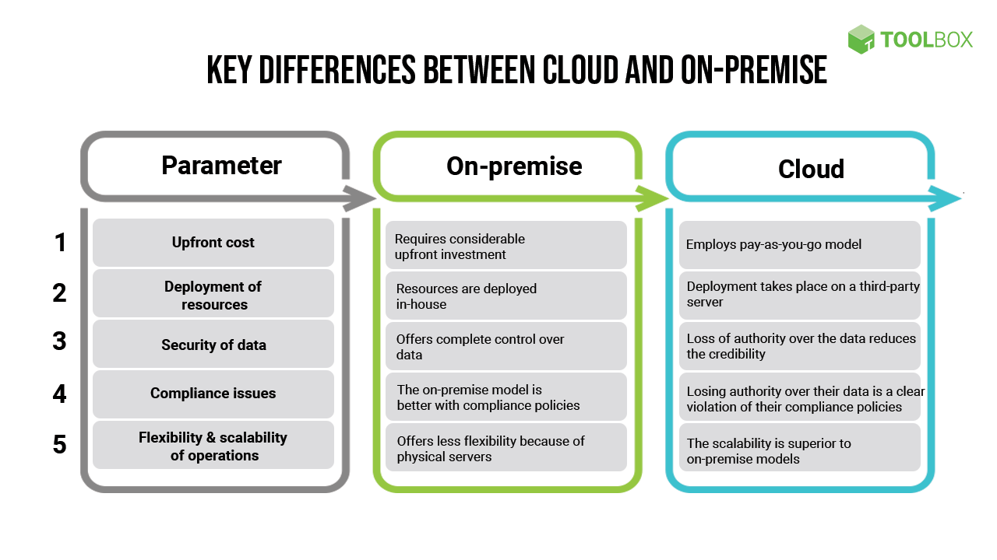
Why to deploy on CLOUD

Slide 17

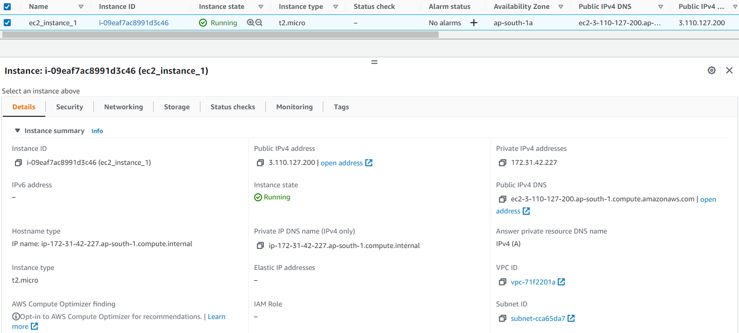
AWS(Amazon Web Services)
Our model was deployed in AWS-EC2 ubuntu free tier instances
PuTTY is a free SSH client that allows connect “ec2-instances” you to do this from a local computer running Windows.
WinSCP tool also used to transfer file to ubuntu OS EC2 server.

Slide 18
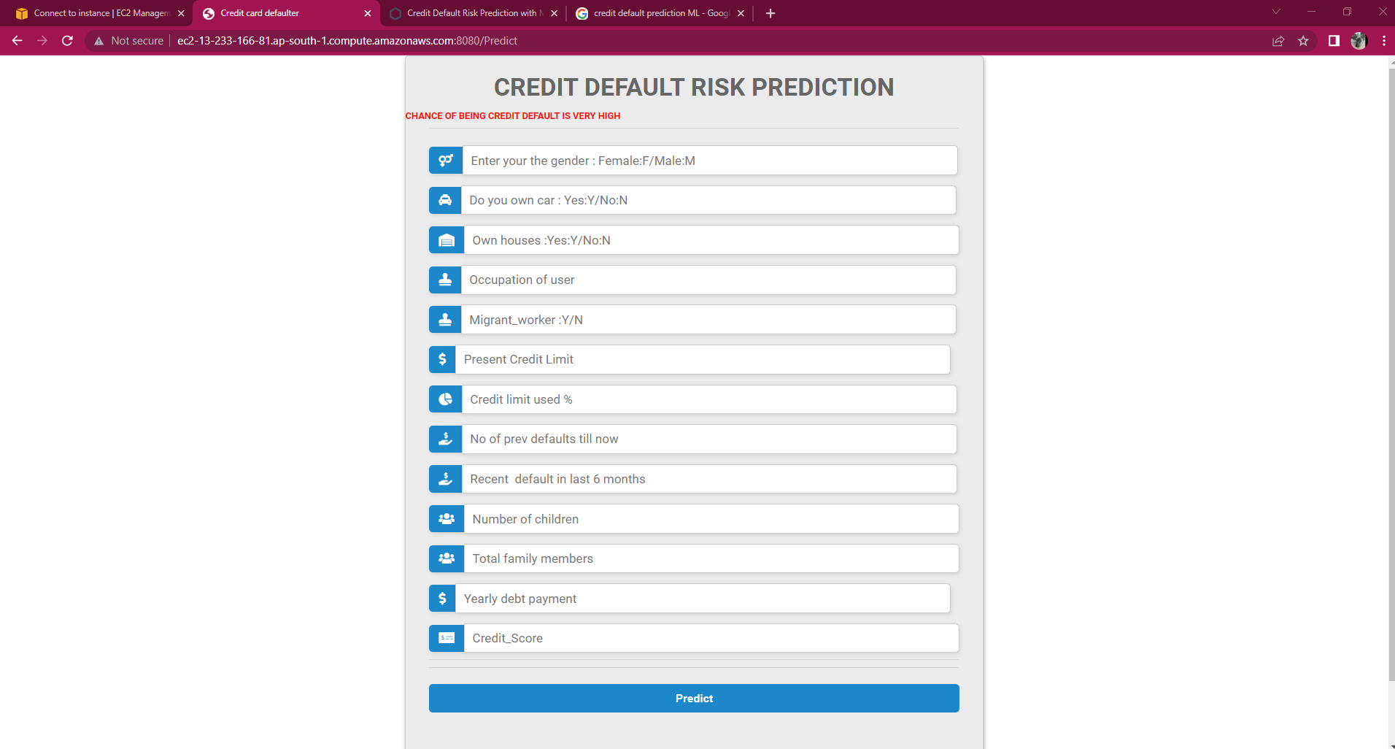
FINAL !! Demonstrations
Running Project Demonstration Link-
http://ec2-13-127-226-234.ap-south-1.compute.amazonaws.com:8080/

Slide 19
Conclusion
In conclusion, we credit loan defaulter which we are generating by fetching data of bank customers and performing classification machine learning algorithms on it provide an automated model which predicts a potential
Now that we can predict potential defaulters we can take necessary measures to help them avoid getting into further debts like increasing the alerts to those particular customers.

